Slide 1
Plants vs Zombies Team 10: Critical Hit Studios
Restricted © Siemens AG 2019
Realize innovation.

Slide 2
Agenda: Problem Statement Short Live Demo Pre-recorded Highlights Demo Architecture Diagram Module Description Challenges About the Team

Slide 3
Problem Statement
Creating a clone of Plant vs Zombies game, which is a desktop application. The aim of the game is to protect user’s house from zombies, using magical plants.

Slide 4
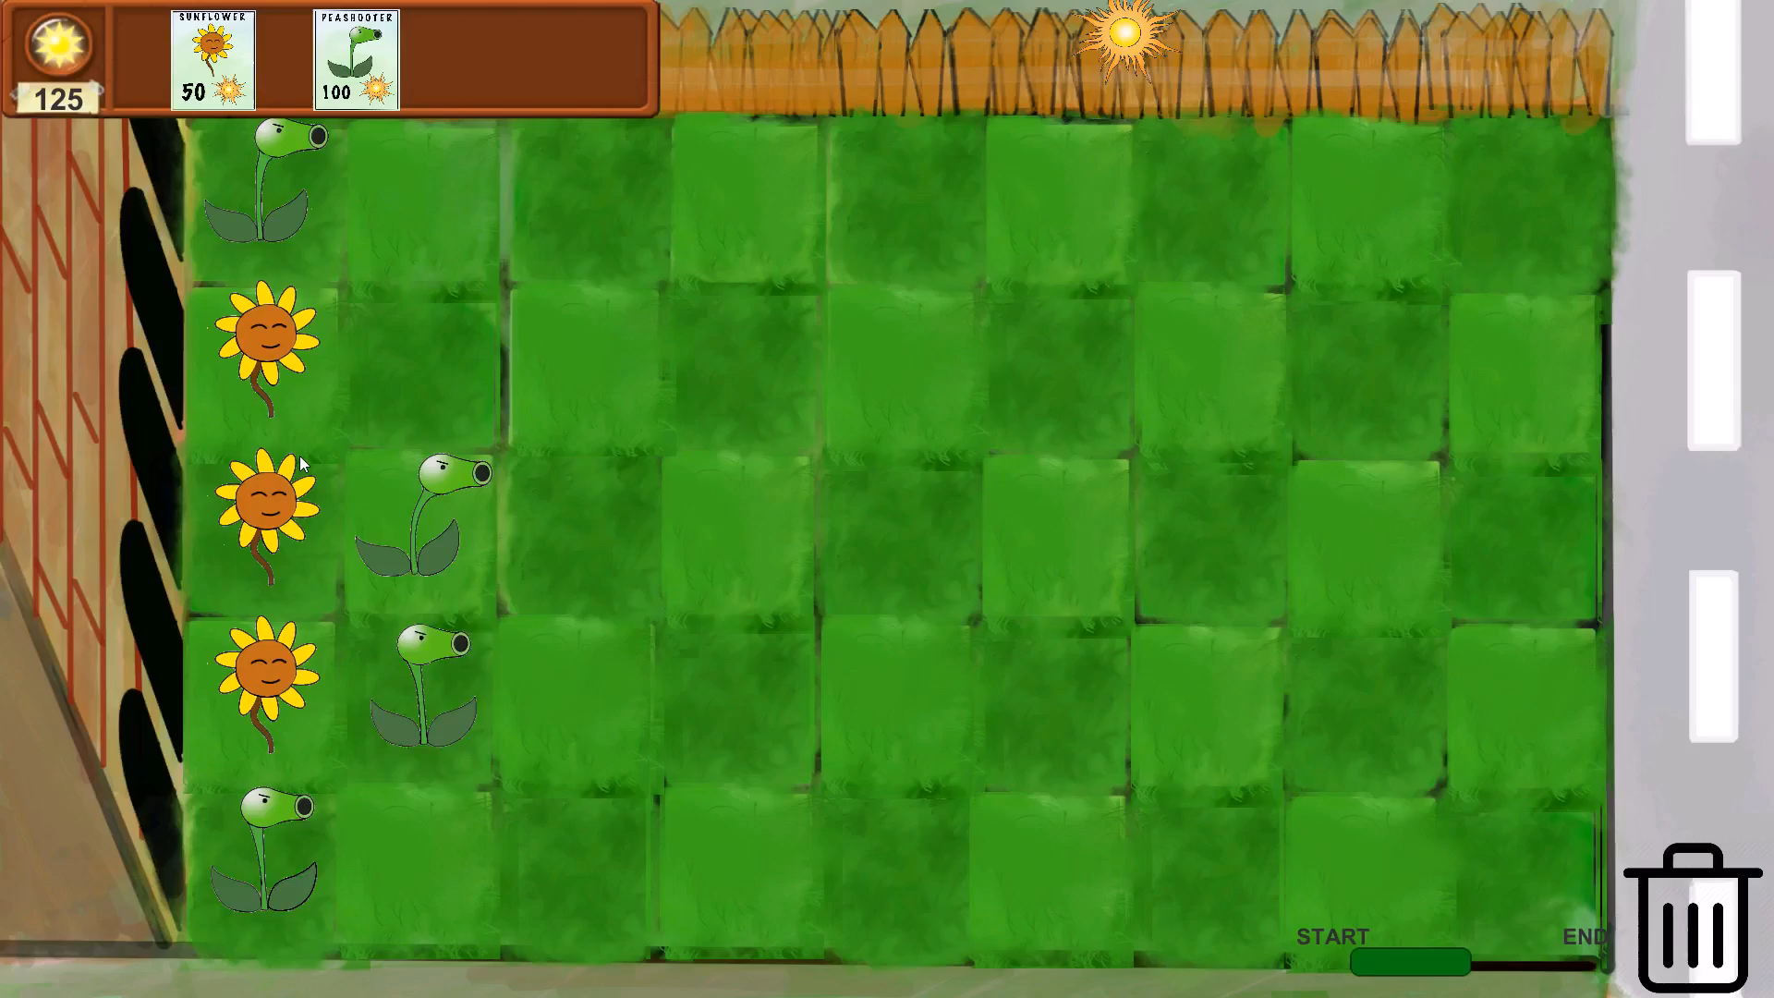

Slide 5
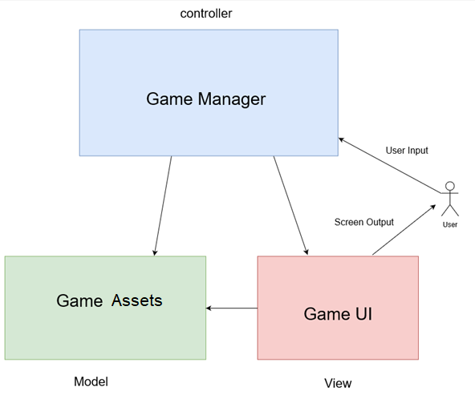
Architecture Diagram :

Slide 6
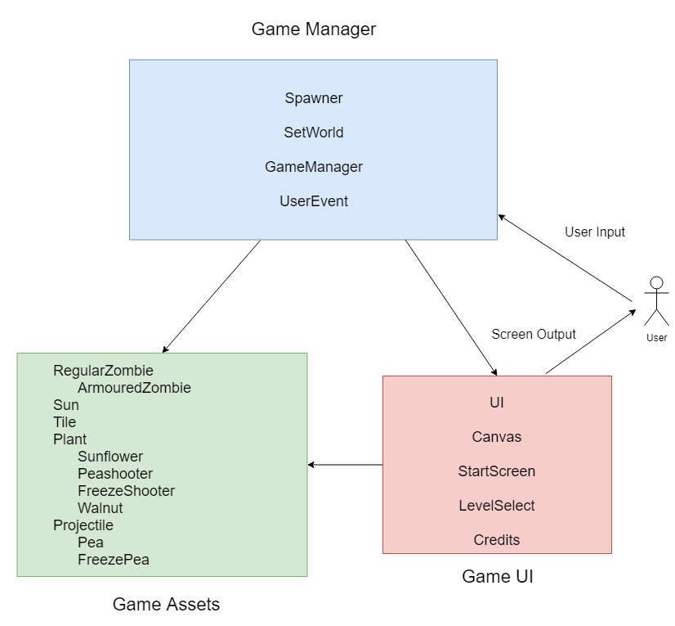
Module description

Slide 7
Key challenges of the problem statement
Class diagram
No cyclic dependency
Interaction between various game assets
Scalability
Game balancing
Game layout (UI)

Slide 8
Requirements and Implementation Traceability
All required requirements were fulfilled.
All desired requirements except for info tooltip were fulfilled. Info tooltip was not implemented because it was complicated to implement properly. So we included a help screen to guide the player.
More features like -
Animations to all Assets
Saving level progress
Cooldown Timer
Dialog Boxes
Level Select Screen
Trash Button
were implemented.

Slide 9
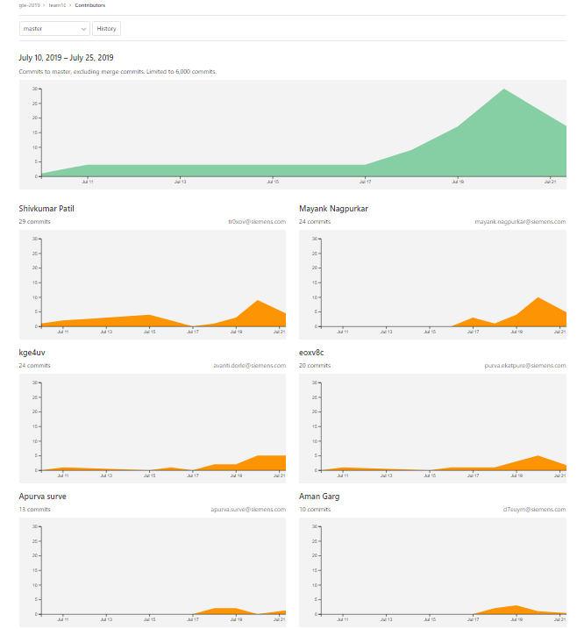
Git Contributors

Slide 10
Code statistics
TOTAL NO. OF CODE LINES
1605
TOTAL NO. OF CODE FILES
22
TOTAL NO. OF COMMITS IN GIT REPOSITORY
150
AVG. NO. OF COMMITS PER DAY
Approximately 12

Slide 11
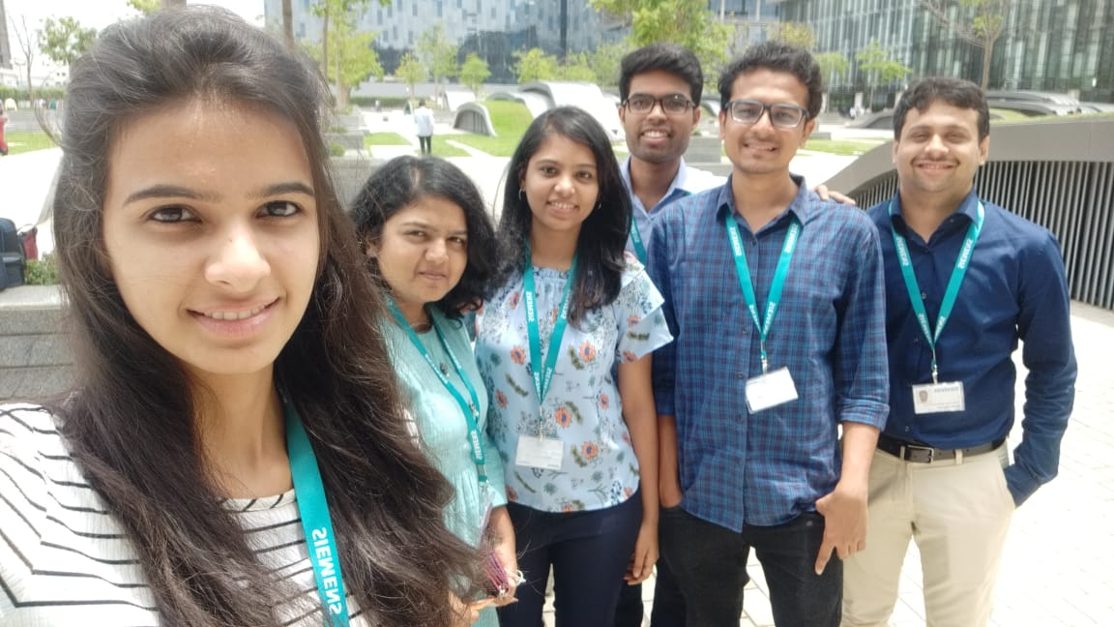
Team ‘Critical Hit Studios’ & Tasks List
Aman : Assets making, functionality of sun count, trash, UI of start screen, level select screen, Code review,
Apurva : Audio background, audio source managing, sound effects, Help screen
Avanti : Functionalities of pea shooter, freeze plant, pea, freeze pea, pea-zombie collision and death
Mayank : Functionalities of grid, sun, horde, user event, check path, save, smoke, game manager
Purva : Functionalities of regular & armoured zombies, game lose, spawning zombies, game balancing, progress bar
Shivkumar : Functionalities of tile, panel, dialog box, game win, walnut, user event, game manager

Slide 12
Presenters
Team 10 : Critical Hit Studios
Mentor : Nilesh Gupta
Aman Garg
Apurva Surve
Avanti Dorle
Mayank Nagpurkar
Purva Ekatpure
Shivkumar Patil

Slide 13
Thank you.

